Slide 1

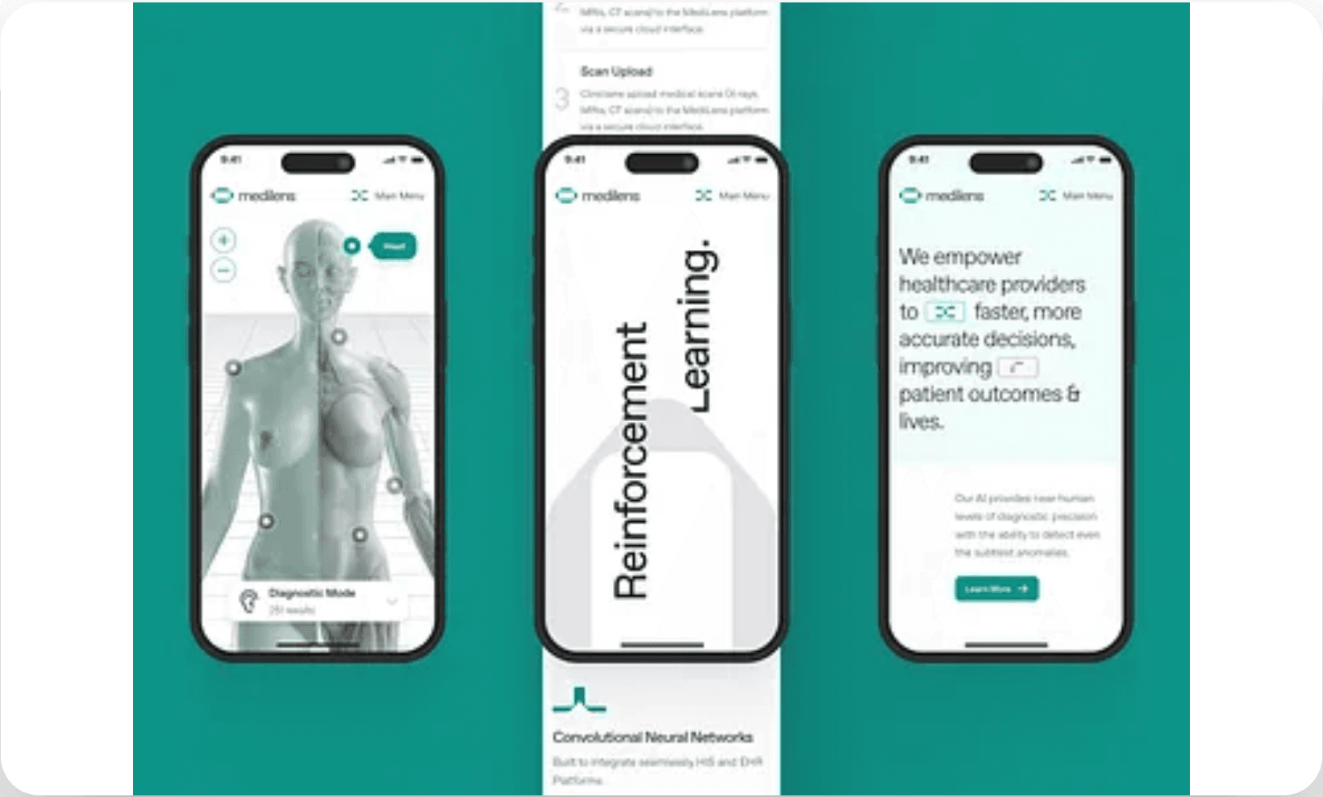


An End-to-End AI Clinical Decision Support Platform
Using Retrieval-Augmented Generation (RAG)
SMD. Jabir Hussain, S. Moinuddin, A.Lasya, K.Lasya, S. Rizwan
B.Tech Final-Year Research Project
Department of Computer Science and Engineering

Slide 2





Problem Formulation: Challenges in Clinical Decision Support
Traditional CDSS Limitations
High-Stakes Domain Requirements
•
Rule-based systems are static and lack flexibility for complex clinical scenarios.
•
Healthcare demands extreme accuracy and explainability.
•
Need for up-to-date medical knowledge integration.
•
Difficult to update with rapidly evolving medical literature.
•
System-level reliability over isolated prototypes.
•
High maintenance overhead for manual rule curation.
LLM Potential & Risks
Current Trend
•
Advanced reasoning capabilities but prone to
Rapid adoption of Retrieval-Augmented Generation (RAG) to bridge the gap between static rules and dynamic AI reasoning.
Recent studies report improved diagnostic accuracy and guideline adherence when RAG is applied in clinical workflows.
hallucinations
.
•
Lack of grounding in verified medical facts.
•
Privacy risks and unreliable outputs in critical care.

Slide 3




Scope and Objectives of the Project
Primary Objective
Scope of Work
Target Users
To develop a deployable, end-to-end AI platform that provides grounded clinical decision support using Retrieval-Augmented Generation (RAG).
Support clinicians with reliable, literature-backed insights.
Bridge the gap between AI reasoning and medical evidence.
Implementation of a RAG-based AI service for context-aware clinical Q&A.
Clinicians and healthcare professionals requiring reliable, evidence-based information.
Development of a full-stack architecture (React, Node.js, Python).
Key Focus
Integration of vector databases for real-time clinical knowledge retrieval.
Accuracy, Explainability, Reliable outputs Transparent reasoning and Deployment-Ready Design.

Slide 4


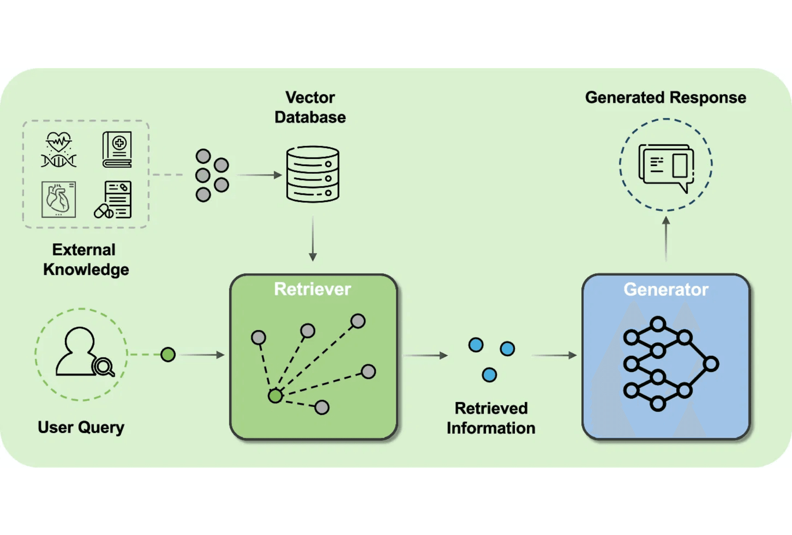


Literature Survey: State of the Art in Clinical AI
RAG in Healthcare
•
Systematic reviews indicate RAG significantly reduces hallucinations compared to standalone LLMs.
Frameworks like clinical RAG and BioMed RAG. Focus on task-specific clinical pipelines
Ensures evidence-aligned, continuously updated, and trusted AI guidence.
•
Current Landscape
•
Most research is concentrated on conceptual models or isolated prototypes
Many systems lack clinical validation and comprehensive evaluation.
•
Lack of standardized evaluation for end-to-end, deployable systems.
Relevance
The shift towards "grounded generation" is the current gold standard for high-reliability AI applications in medicine.
Evidence-backed AI reduces clinician skepticism.
Figure 1: Conceptual Workflow of Retrieval-Augmented Generation (RAG)
Present Context Relevance

Slide 5





Identifying Research and Product Gaps
01
Lack of End-to-End Systems
Most existing works focus on isolated AI models, neglecting the full-stack deployment and real-world clinician interfaces.
Project Contribution
02
Absence of System-Level Evaluation
Full-stack, deployable RAG platform.
Limited data on production metrics such as end-to-end latency, grounding accuracy, and clinician usability.
Comprehensive system-level metrics.
03
Integration & Safety Concerns
Persistent clinical reasoning via chat.
Insufficient discussion on persistent chat sessions, session handling, and clinical safety guardrails in RAG pipelines.
Modular, privacy-conscious design.
04
Insufficient Clinical Validation
Evidence is largely limited to offline studies, with minimal real-world or long-term validation.

Slide 6
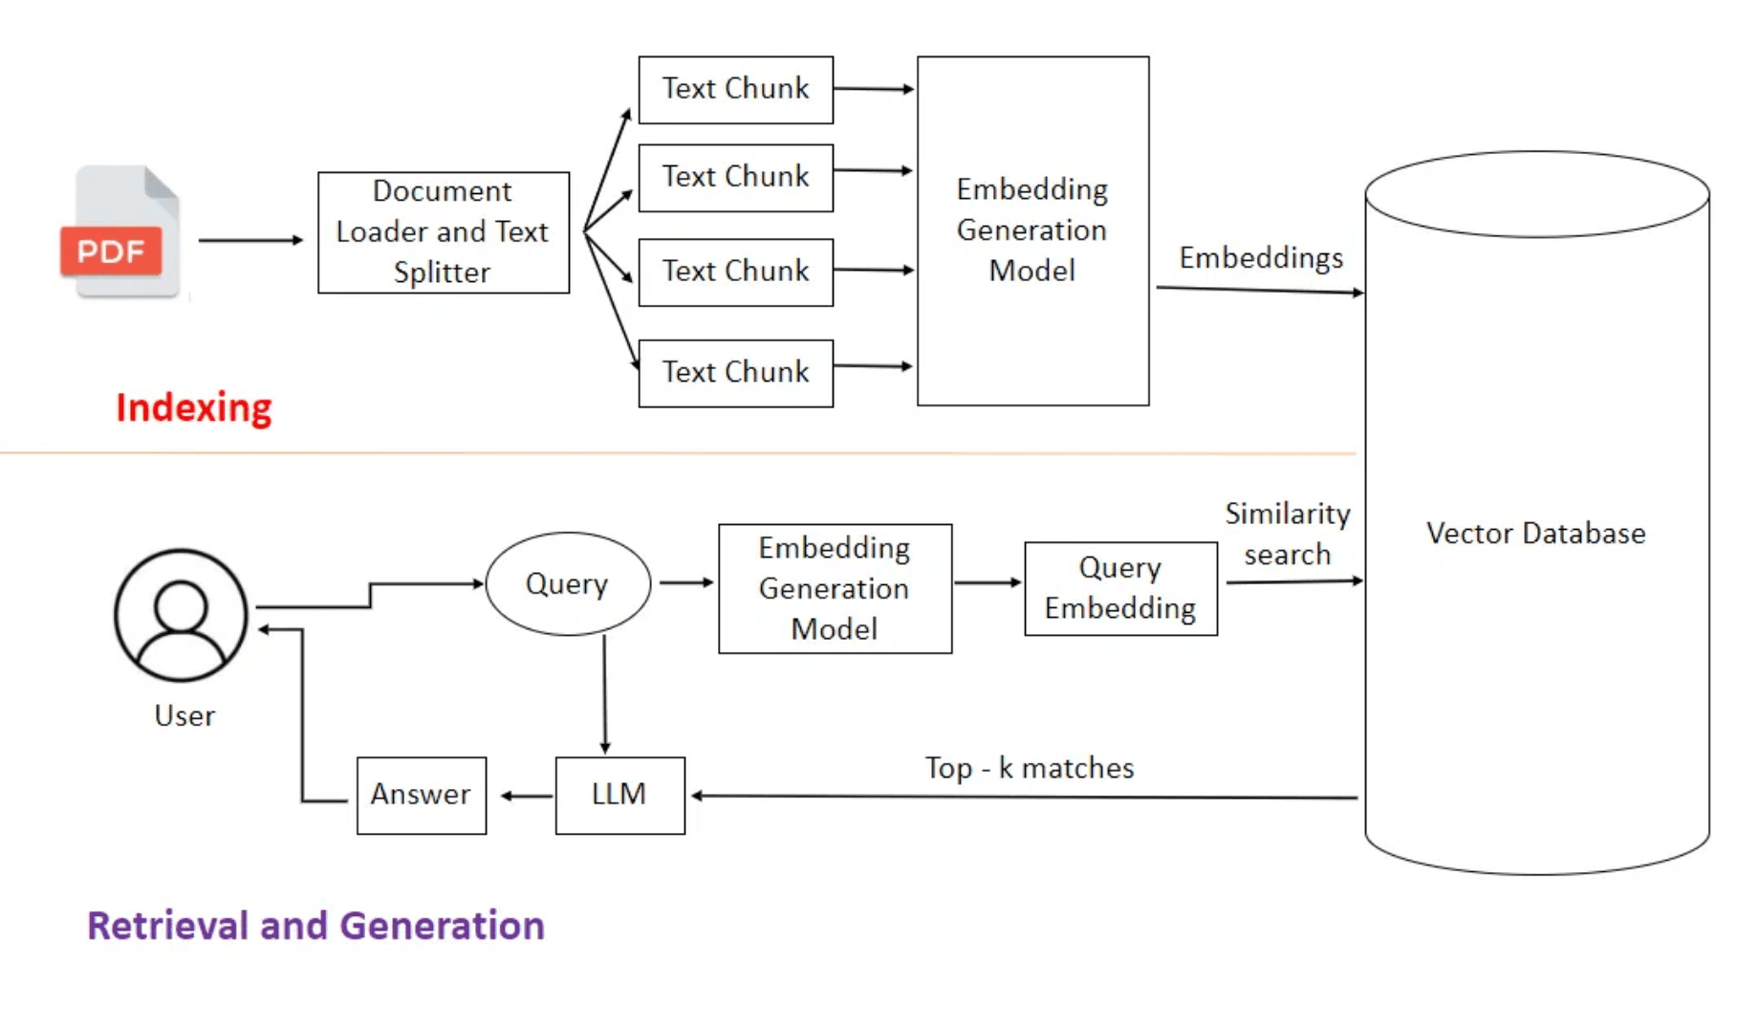






Methodology: System Architecture and RAG Pipeline
Full-Stack Integration
Frontend: React-based clinician interface for seamless chat interactions.
Backend: Node.js for secure authentication and API orchestration.
AI Service: Python + FastAPI implementing the core RAG logic.
The RAG Workflow
Ingestion: Recursive document chunking with overlap.
Embedding: Dense vectors using a medical embedding model.
Retrieval: Top-k similarity search in a vector database.
Generation: Context-conditioned LLM synthesis.
1. INGESTION
2. EMBEDDING
3. RETRIEVAL
4. GENERATION
Figure 1: End-to-End Retrieval-Augmented Generation Architecture

Slide 7

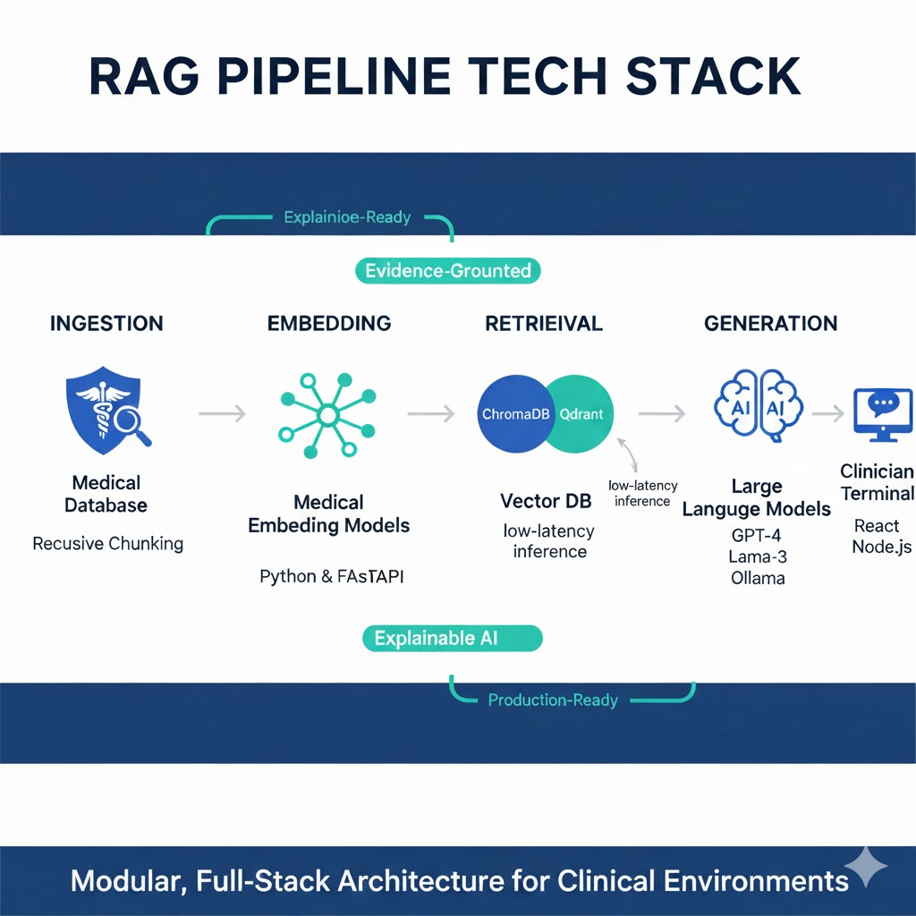



Methodology: Technical Implementation Details
AI Components
•
State-of-the-art LLMs (Ollama 3.1 Model) for clinical reasoning.
•
Specialized medical embeddings for high-precision retrieval.
•
FastAPI-based AI service for low-latency inference.
Data Management
•
Recursive character splitting for optimal clinical context chunking.
•
Vector similarity search using Qdrant Vector DB.
•
Automated knowledge ingestion pipeline for medical literature.
System Features
•
Persistent clinical reasoning via session-based chat history.
•
Context-aware Q&A tailored to specific medical domains.
•
Figure 2: Technical Workflow for Knowledge Indexing and Retrieval
Modular design for seamless knowledge base updates.

Slide 8
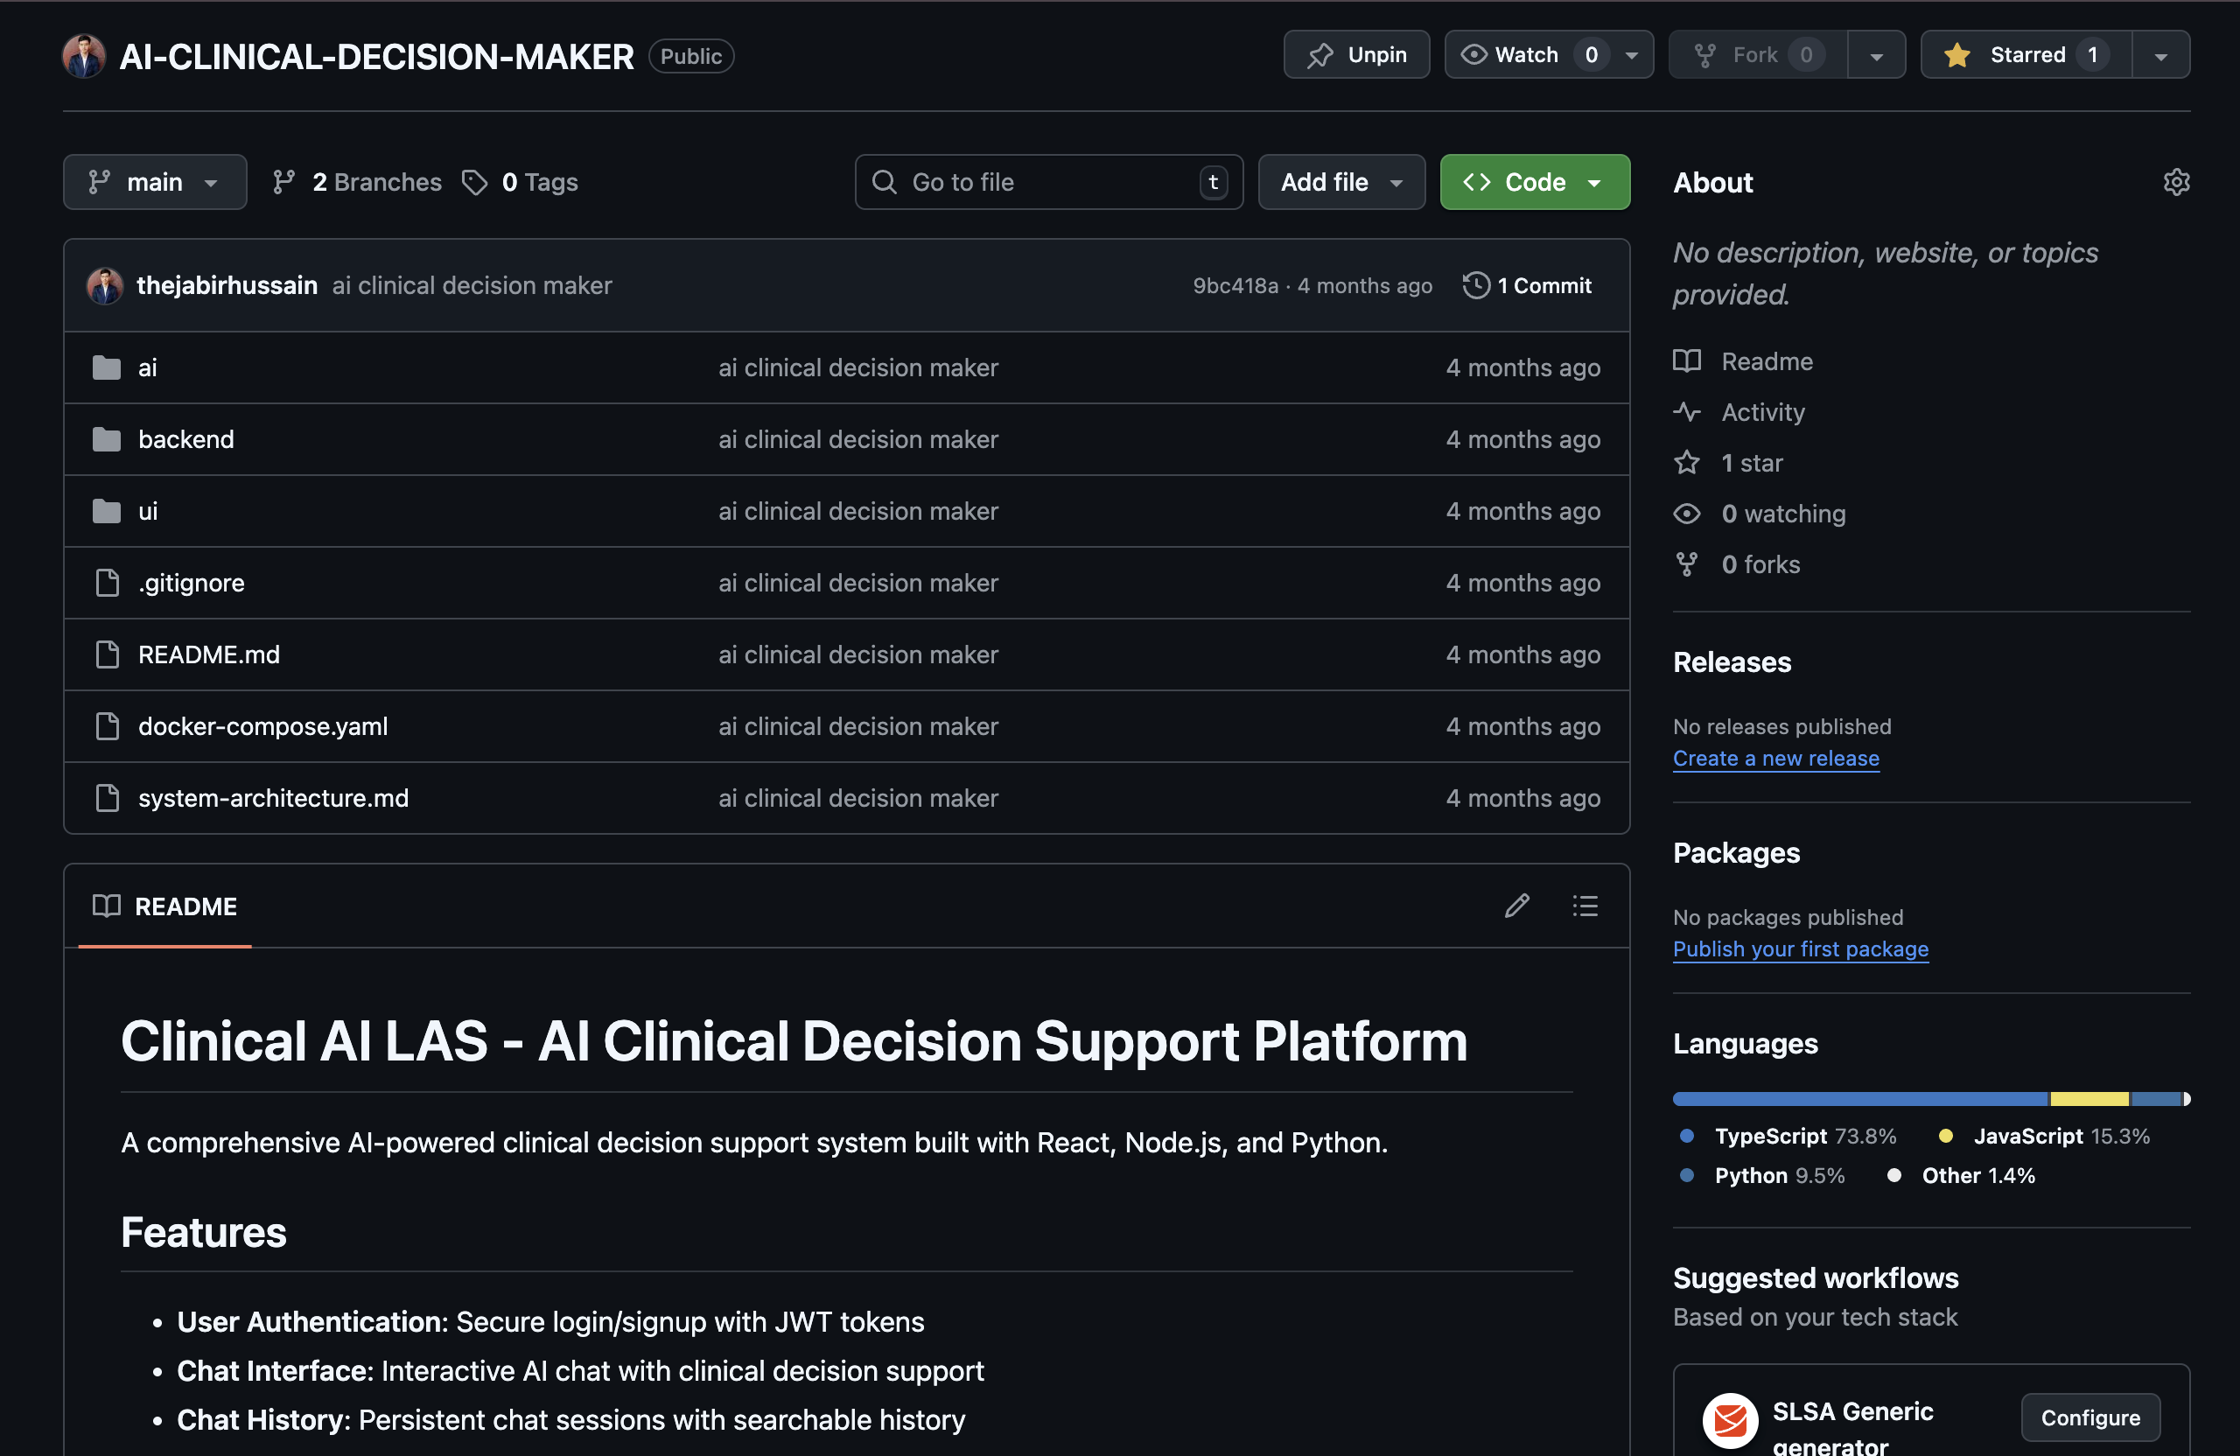




Novelty and Innovation
System-Level Integration
Moving beyond algorithmic novelty to provide a comprehensive, production-oriented platform for clinical use.
End-to-End Design
Seamless integration of React frontend, Node.js backend, and Python AI services into a single deployable unit.
Privacy-Conscious Architecture
Designed with deployment-ready security, session management, and clinical safety guardrails.
Persistent Reasoning
Production-Ready Interface
Implementation of persistent chat sessions to support long-term clinical decision-making processes.

Slide 9




Expected Outcomes and Performance Metrics
Anticipated Results
Evaluation Metrics
Reduced Hallucinations
Metric Category
Target Outcome
Significant improvement in factual accuracy compared to standalone LLM systems.
Grounding Score
> 90% Accuracy
Enhanced Explainability
Responses are generated using explicitly retrieved clinical documents with clear source attribution to support clinical validation.
Retrieval Precision
Top-K( 80 Docs) Relevance
System Latency
< 3s Response Time
System Scalability
The modular architecture enables efficient handling of increasing clinical data volumes and concurrent user load.
Clinician Usability
Positive SUS Score
Enhanced Diagnostic Accuracy
Improved clinical decision accuracy over baseline LLM systems through evidence-grounded retrieval.

Slide 10



Conclusion and Future Work
Project Summary
Future Directions
Successfully designed and implemented an end-to-end RAG platform for clinical decision support.
EHR Integration:
Seamless connection with Electronic Health Records for real-time patient data context.
Addressed critical gaps in grounding, accuracy, and system-level deployment in healthcare AI.
Multi-modal RAG:
Incorporating medical imaging and diagnostic reports into the retrieval pipeline.
•
Demonstrates the feasibility of RAG-based CDSS, emphasizing evidence grounding and the importance of system-level evaluation.
Clinical Validation:
Large-scale studies to measure impact on clinician efficiency and patient outcomes.
•
Real-Time Knowledge Updates:
Automated ingestion of newly published clinical guidelines and medical literature to maintain up-to-date decision support.
Key Takeaway: System-level integration is essential for moving AI from research prototypes to reliable clinical decision support tools.

Slide 11
References
References
[1]
Lewis, P., Perez, E., Piktus, A., Petroni, F., Karpukhin, V., Goyal, N., Küttler, H., Lewis, M., Yih, W.-T., Rocktäschel, T., Riedel, S., & Kiela, D. (2020).
Retrieval-Augmented Generation for Knowledge-Intensive NLP Tasks.
Advances in Neural Information Processing Systems (NeurIPS), 33, 9459–9474.
[1]
Lewis, P., et al. (2020). "Retrieval-Augmented Generation for Knowledge-Intensive NLP Tasks." Advances in Neural Information Processing Systems (NeurIPS).
[2]
Amugongo, L. M., Mascheroni, P., Brooks, S., Doering, S., & Seidel, J. (2025).
Retrieval-Augmented Generation for Large Language Models in Healthcare: A Systematic Review.
PLOS Digital Health, 4(6), e0000877.
https://doi.org/10.1371/journal.pdig.0000877
[2]
Zakka, C., et al. (2024). "Almanac: Retrieval-Augmented Language Models for Clinical Medicine." NEJM AI.
[3]
Neha, F., Bhati, D., & Shukla, D. K. (2025).
Retrieval-Augmented Generation (RAG) in Healthcare: A Comprehensive Review.
AI, 6(2), 226.
https://doi.org/10.3390/ai6090226
[3]
Thirunavukarasu, A. J., et al. (2023). "Large language models in medicine." Nature Medicine.
[4]
Technical Documentation: FastAPI, React, Node.js, and Vector Database (ChromaDB/Qdrant) Official Documentation (2024-2025).
[4]
Bunnell, D. J., Bondy, M. J., Fromtling, L. M., Ludeman, E., & Gourab, K. (2025).
Bridging AI and Healthcare: A Scoping Review of Retrieval-Augmented Generation—Ethics, Bias, Transparency, Improvements, and Applications.
medRxiv (Preprint).
https://doi.org/10.1101/2025.04.01.25325033
[5]
Hybrid Retrieval-Augmented Generation Systems with Embedding Vector Databases.
International Journal of Scientific Research in Computer Science, Engineering and Information Technology, 11(2), 2694–2702.
https://doi.org/10.32628/CSEIT25112702
[6]
Thirunavukarasu, A. J., Ting, D. S. W., Elangovan, K., Gutierrez-Castrellon, P., Cheung, G., & Lee, A. Y. (2023).
Large Language Models in Medicine.
Nature Medicine, 29, 1930–1940.
https://doi.org/10.1038/s41591-023-02448-x
* All references cited follow standard academic formatting for B.Tech project evaluation.
* All references cited follow standard academic formatting for B.Tech project evaluation.

